Slide 1

Team DJJX
Jordan Pflum
Jason Petri
Dylan Nikol
Xuxian Chen

Slide 2
Presentation Overview
01
02
03
04
Motivations & Objective
Dataset Proposal
State the goal of this research project
Data collection & filtering
Bankruptcy Modeling
Model Performance
Logistic regression and preliminary machine learning models
Results and next steps

Slide 3
Research Objective
Explore the relationship between bankruptcy and US equity returns
The distress risk anomaly - the tendency for stocks with high credit risk to perform poorly - presents evidence to reject the CAPM
Modeling Bankruptcy
Evaluate Performance
Form Portfolios
Logit model to predict bankruptcy
Sort on probability of bankruptcy
Alphas, coefficients, t-stats

Slide 4
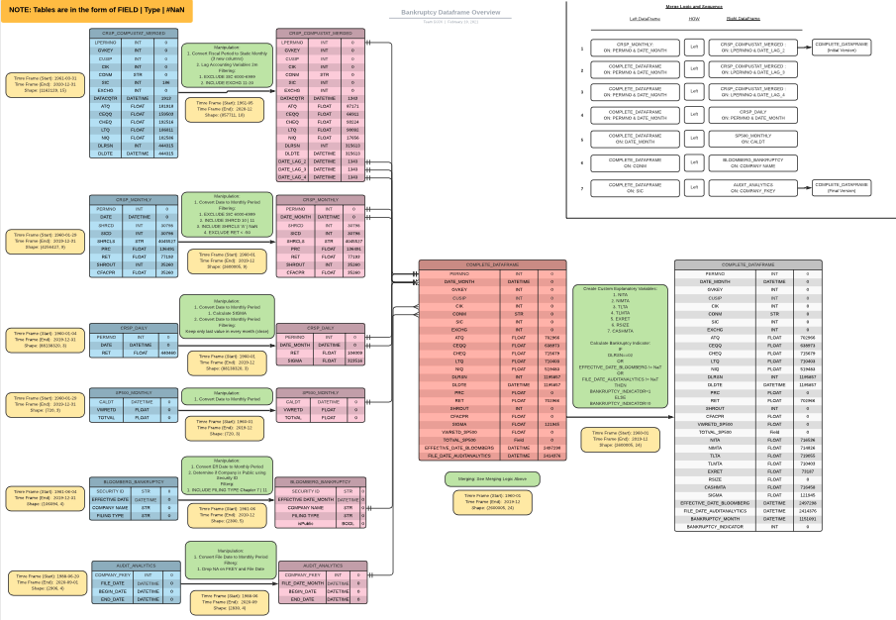
Dataset Proposal

Slide 5
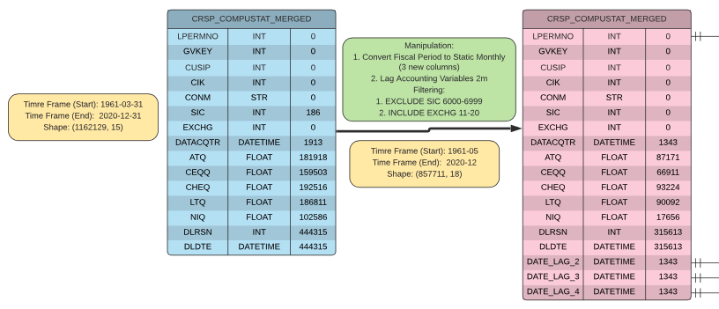
CRSP Compustat Merged

Slide 6
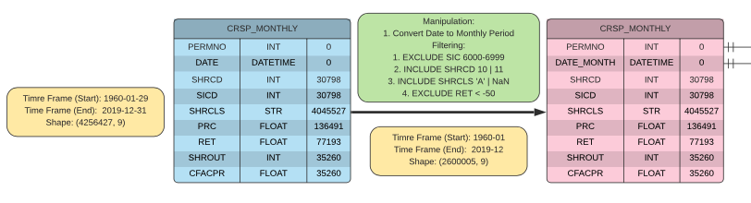
CRSP Monthly

Slide 7
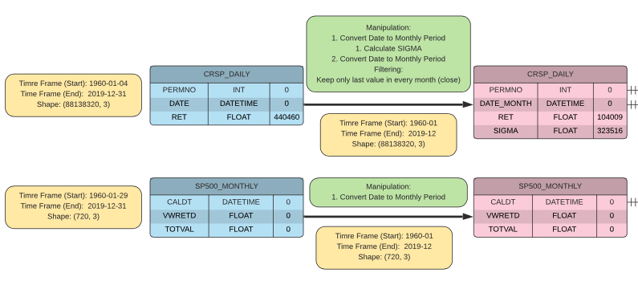
CRSP Daily and S&P Monthly

Slide 8
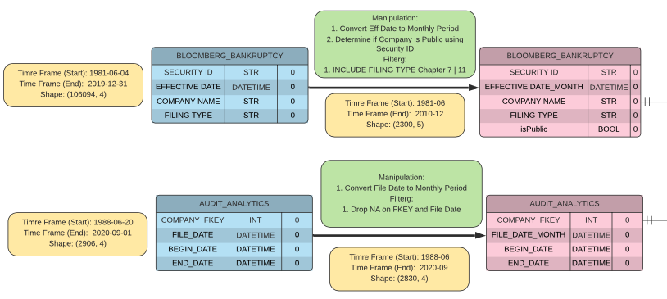
Bloomberg Corporate Actions & Audit Analytics

Slide 9
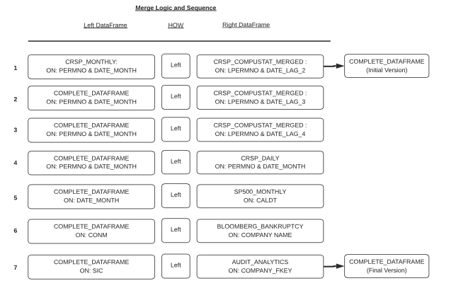
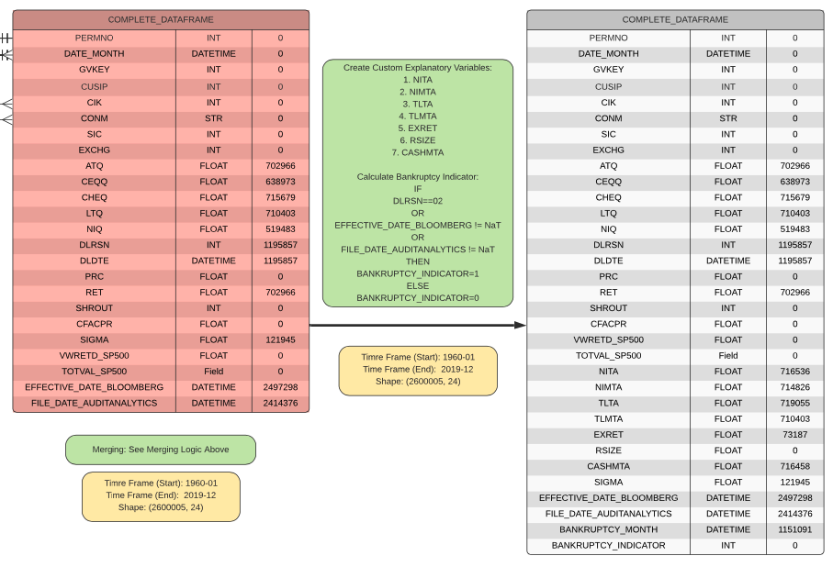
Merge Logic and Sequence

Slide 10
Complete Dataset

Slide 11
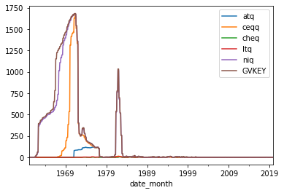
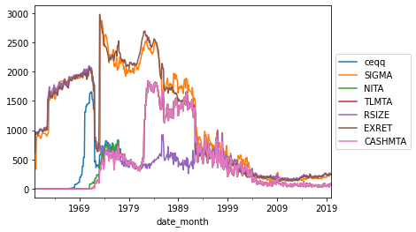
NaN Distribution
CCM + CRSP Monthly CCM + CRSP Monthly + Computed Parameter

Slide 12
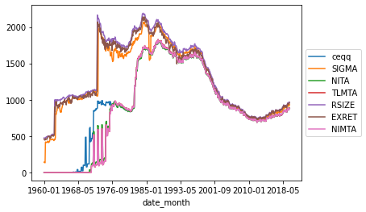
Final DF NaN Distribution (Selective)

Slide 13
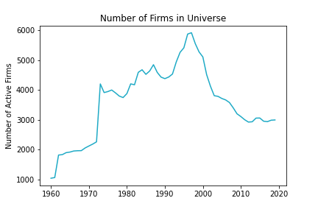
Previous Week Recap - Universe Creation

Slide 14
Previous Week Recap - Explanatory Variables
Variable | Code | Type
Net Income per Adjusted Total Assets | NITA | Fundamental
Net Income per Enterprise Value | NIMTA | Fundamental
Total Liabilities per Adjusted Total Assets | TLTA | Fundamental
Total Liabilities Per Enterprise Value | TLMTA | Fundamental
Excess Returns | EXRET | Fundamental
Relative Size | RSIZE | Fundamental
Standard Deviation of Returns | SIGMA | Fundamental
Cash Per Enterprise Value | CASHMTA | Fundamental

Slide 15
New Explanatory Variables
Variable | Code | Type
Jaccard Similarity | JACCARD | Technical
Cosine Similarity | COSINE | Technical
Minimum Edit Distance | MinEditDist | Technical
Net Income per Adjusted Total Assets (3 Month Lag) | NITA_LAG_3 | Fundamental
Net Income per Enterprise Value (3 Month Lag) | NIMTA_LAG_3 | Fundamental
... | ... | ...
Cash Per Enterprise Value (3 Month Lag) | CASHMTA_LAG_3 | Fundamental

Slide 16
Variables Overview - Text Related
'COSINE'
'JACCARD_M'
'JACCARD'
'MinEditDist'
Rationale:
Qualitative similarity and stock price comovement
The Positive Similarity of Company Filings and the Cross-Section of Stock Returns
Notes:
https://www.sciencedirect.com/science/article/abs/pii/S0378426618300773
https://papers.ssrn.com/sol3/papers.cfm?abstract_id=3690461

Slide 17
Modeling - Logistic Regression (Framework)
Time Dependent
Run a logistic regression on various time periods:
1960 - 2019
1960 - 1990
1990- 2019
3
Bankruptcy Indicator Time Frame
Adjust the time frame for bankruptcy to have occurred for indicator to be positive
3 months
6 months
1 Year
2 Years
5 Years
2
All Data
Run a logistic regression on all data.
1

Slide 18
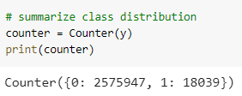
Modeling - Unbalanced Sample
class_weight
from sklearn.linear_model import LogisticRegression
The values of y to automatically adjust weights inversely proportional to class frequencies in the input data using:
n_samples / (n_classes * np.bincount(y))
SMOTE (synthetic minority oversampling technique)
from imblearn.over_sampling import SMOTE
randomly increasing minority class examples by replicating them - synthesises new minority instances between existing minority instances

Slide 19
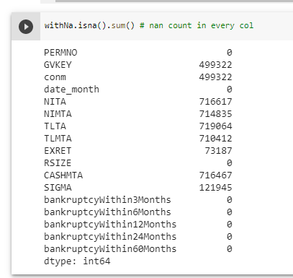
Handling NaN

Slide 20
Modeling - Logistic Regression (Results)
feature_list = ['NITA',' NIMTA', 'TLTA', 'TLMTA', 'EXRET', 'RSIZE', 'SIGMA', 'CASHMTA']
Target = bankruptcyWithin60Months
Time Frame = All fillna(‘bfill’) Train-Test split: 7:3
Across all data & whole period | Confusion Matrix On Test Set |  | Across all data & whole period | Confusion Matrix On Test Set
Class_weight | 584970 (TN) | 187835 (FP) | Class_weight + log | 554746 | 215544
 | 2310 (FN) | 3081 (TP) |  | 1609 | 3644
Specificity | Sensitivity | 75.6% | 57.15% | Specificity | Sensitivity | 20.02% | 69.37%
Across all data & whole period | Confusion Matrix On Test Set |  | Across all data & whole period | Confusion Matrix On Test Set
Class_weight + binning | 721899 | 50906 | ZTE | 769446 | 3292
 | 4879 | 512 |  | 75933 | 1392
Specificity | Sensitivity | 93.41% | 09.49% | Specificity | Sensitivity | 99.57% | 18.00%
Notes:
Sensitivity (aka Recall) means "out of all actual bankrupcies, how many did we predict as bankrupt", which can be explained as: Sensitivity (Recall) = TP / (FN + TP)
Specificity (aka Selectivity or True Negative Rate, TNR) means "out of all actual Negatives, how many did we predict as Negative", and can be written as: Specificity = TN / (TN + FP)
Accuracy = (TP + TN) / All Predictions
Mis-Classification is (1-Accuracy), and means all false predictions over the total number of predictions.
Precision (aka Positive Predictive Value, PPV) means "out of all predicted Positive cases, how many were actually Positive" Precision = TP / (TP + FP)
F1 Score is the harmonic, or weighted, an average of Precision and Sensitivity, and is a widely used measure of accuracy for classification problems. It is calculated as: F1 Score = 2 * (Precision * Sensitivity) / (Precision + Sensitivity)

Slide 21
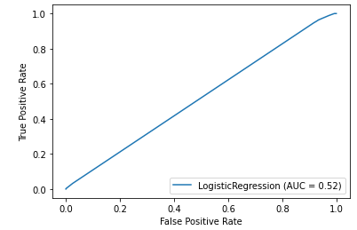
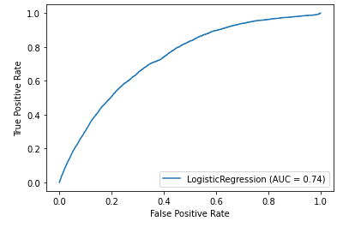
Binning data versus non-binning
Non-binning
Binning @ 5 bins
15 bins is just as bad!

Slide 22
Model Results:
'NITA', 'NIMTA', 'TLTA', 'TLMTA', 'EXRET', 'RSIZE', 'CASHMTA', 'SIGMA', 'COSINE', 'JACCARD_M', 'JACCARD', 'MinEditDist'
Time Frame | Bankruptcy Periods | Sensitivity | Specificity
All time | 3 months | 83.3% | 85.9%
All time | 6 months | 71.9% | 85.3%
All time | 12 months | 68.9% | 83.5%
All time | 24 months | 66.5% | 80.5%
All time | 60 months | 57.1% | 76.0%
Notes:
Sensitivity (Recall) = TP / (FN + TP)
# Specificity (aka Selectivity or True Negative Rate, TNR) means "out of all actual Negatives,
# how many did we predict as Negative", and can be written as:
# Specificity = TN / (TN + FP)
# Precision (aka Positive Predictive Value, PPV) means "out of all predicted Positive cases,
# how many were actually Positive", or
# Precision = TP / (TP + FP)

Slide 23
Model Results:
'NITA', 'NIMTA', 'TLTA', 'TLMTA', 'EXRET', 'RSIZE', 'CASHMTA', 'SIGMA', 'COSINE', 'JACCARD_M', 'JACCARD', 'MinEditDist'
Time Frame | Bankruptcy Periods | Sensitivity | Specificity
1960-1989 | 3 months | 90.9% | 91.1%
1960-1989 | 6 months | 73.5% | 87.1%
1960-1989 | 12 months | 69.9% | 85.7%
1960-1989 | 24 months | 70.1% | 83.1%
1960-1989 | 60 months | 63.4% | 79.1%
Notes:
Sensitivity (Recall) = TP / (FN + TP)
# Specificity (aka Selectivity or True Negative Rate, TNR) means "out of all actual Negatives,
# how many did we predict as Negative", and can be written as:
# Specificity = TN / (TN + FP)
# Precision (aka Positive Predictive Value, PPV) means "out of all predicted Positive cases,
# how many were actually Positive", or
# Precision = TP / (TP + FP)

Slide 24
Model Results:
'NITA', 'NIMTA', 'TLTA', 'TLMTA', 'EXRET', 'RSIZE', 'CASHMTA', 'SIGMA', 'COSINE', 'JACCARD_M', 'JACCARD', 'MinEditDist'
Time Frame | Bankruptcy Periods | Sensitivity | Specificity
1989 - 2019 | 3 months | 83.3% | 88.2%
1989 - 2019 | 6 months | 80.0% | 92.9%
1989 - 2019 | 12 months | 81.9% | 91.7%
1989 - 2019 | 24 months | 66.0% | 82.0%
1989 - 2019 | 60 months | 54.3% | 76.1%
Notes:
Sensitivity (Recall) = TP / (FN + TP)
# Specificity (aka Selectivity or True Negative Rate, TNR) means "out of all actual Negatives,
# how many did we predict as Negative", and can be written as:
# Specificity = TN / (TN + FP)
# Precision (aka Positive Predictive Value, PPV) means "out of all predicted Positive cases,
# how many were actually Positive", or
# Precision = TP / (TP + FP)

Slide 25
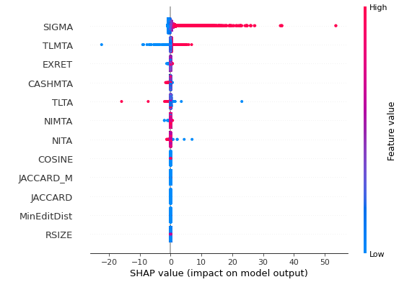
Model Sensitivity
Keep in mind, our model does not perform well.
Model Description:
60 month bankruptcy
All time history

Slide 26
Model Results:
'NITA', 'NIMTA', 'TLTA', 'TLMTA', 'EXRET', 'RSIZE', 'CASHMTA', 'SIGMA', 'COSINE', 'JACCARD_M', 'JACCARD', 'MinEditDist'
Time Frame | Bankruptcy Periods | Sensitivity | Specificity
All time | 3 months | 75.0% | 94.1%
All time | 6 months | 76.3% | 85.9%
All time | 12 months | 77.4% | 83.7%
All time | 24 months | 68.5% | 81.2%
All time | 60 months | 60.0% | 75.8%
With 1 month and 3 month lagging variables: 'NITA', 'NIMTA', 'TLTA', 'TLMTA', 'EXRET', 'RSIZE', 'CASHMTA', 'SIGMA'
Notes:
Sensitivity (Recall) = TP / (FN + TP)
# Specificity (aka Selectivity or True Negative Rate, TNR) means "out of all actual Negatives,
# how many did we predict as Negative", and can be written as:
# Specificity = TN / (TN + FP)
# Precision (aka Positive Predictive Value, PPV) means "out of all predicted Positive cases,
# how many were actually Positive", or
# Precision = TP / (TP + FP)

Slide 27
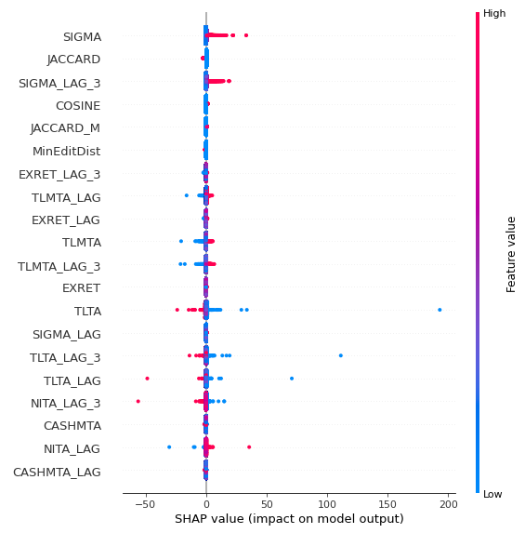
Model Sensitivity
Keep in mind, our model does not perform well.
Model Description:
60 month bankruptcy
All time history

Slide 28
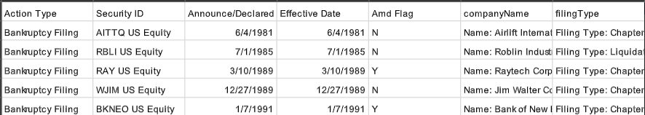
Bankruptcy Indicator - Bloomberg Data
From bankruptcy filings
Issue: Merging require first six digit of cusip but we weren’t able to obtain a security id & cusip pair data from bloomberg
Solution: Merged via company name

Slide 29
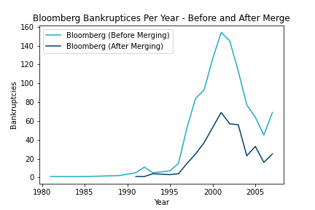
Bankruptcy Indicator - Bloomberg Data

Slide 30
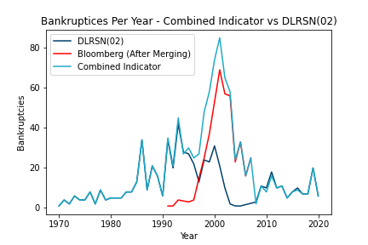
Bankruptcy Indicator - Combined Indicator

Slide 31
Bankruptcy Indicator - DLRSN
Observed Fact: DLRSN Bankruptcy Code (02) shows significantly less bankruptcies for firms then we would expect or can confirm.
Firms who were in process of going bankrupt were acquired or liquidated by larger and healthier firms
Change in acquisition or bankruptcy strategy
Reasoning
Issue
Firms that have all the characteristics of bankruptcy and would have gone bankrupt but were acquired / delisted for another reason disrupt the indicator
Possible Solution
Develop Criteria / Process for Identifying such firms and reclassifying their DLRSN code as bankruptcy (02)

Slide 32
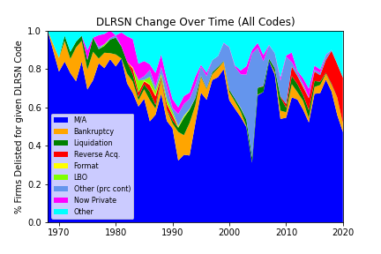
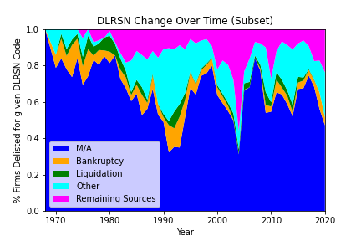
Bankruptcy Indicator - DLRSN (Closer Analysis)

Slide 33
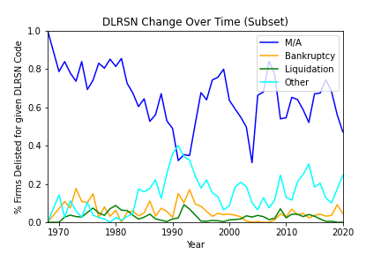
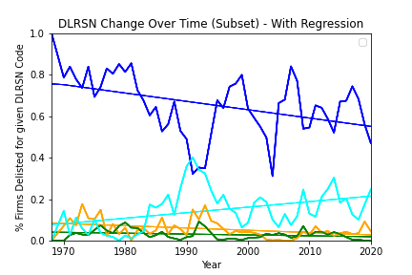
Bankruptcy Indicator - DLRSN

Slide 34
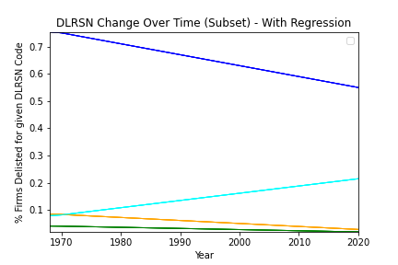
Bankruptcy Indicator - DLRSN
 | Estimate | SE | T-Stat
M/A | -0.0040 | 0.001 | -3.169
Bankruptcy | -0.0011 | 0.000 | -2.954
Liquidation | -0.0004 | 0.000 | -1.995
Other | 0.0027 | 0.001 | 3.162
Significant Change in Delisting Reason for Firms over Time

Slide 35
The Logit Model
Necessary steps:
Imputation of missing values
Scaling the data prior to training
Without, we were unable to have model convergence
Fit the model on all data
No train/test splits!
Considered features:
'NITA', 'NIMTA', 'TLTA', 'TLMTA', 'EXRET', 'RSIZE', 'CASHMTA', 'SIGMA'

Slide 36
The Logit Model
Logit Regression Results
===============================================================================
Dep. Variable: bankruptcyIndicator No. Observations: 2600005
Model: Logit Df Residuals: 2599996
Method: MLE Df Model: 8
Date: Thu, 11 Feb 2021 Pseudo R-squ.: 0.09171
Time: 21:35:55 Log-Likelihood: -13997.
converged: True LL-Null: -15410.
Covariance Type: nonrobust LLR p-value: 0.000
==============================================================================
coef std err z P>|z| [0.025 0.975]
------------------------------------------------------------------------------
const -7.6267 0.030 -254.115 0.000 -7.686 -7.568
NITA -0.0440 0.006 -7.626 0.000 -0.055 -0.033
NIMTA 0.0145 0.005 3.088 0.002 0.005 0.024
TLTA -0.0403 0.003 -13.285 0.000 -0.046 -0.034
TLMTA 0.1042 0.004 24.975 0.000 0.096 0.112
EXRET 0.3056 0.024 12.690 0.000 0.258 0.353
RSIZE -1.7321 0.107 -16.222 0.000 -1.941 -1.523
CASHMTA 0.0083 0.004 1.934 0.053 -0.000 0.017
SIGMA 0.2577 0.006 42.586 0.000 0.246 0.270
==============================================================================

Slide 37
The Logit Model
Logit Regression Results
===================================================================================
Dep. Variable: bankruptcyWithin3Months No. Observations: 2600005
Model: Logit Df Residuals: 2599996
Method: MLE Df Model: 8
Date: Thu, 11 Feb 2021 Pseudo R-squ.: 0.1105
Time: 22:54:45 Log-Likelihood: -45508.
converged: True LL-Null: -51159.
Covariance Type: nonrobust LLR p-value: 0.000
==============================================================================
coef std err z P>|z| [0.025 0.975]
------------------------------------------------------------------------------
const -6.3103 0.017 -377.942 0.000 -6.343 -6.278
NITA -0.0737 0.012 -6.302 0.000 -0.097 -0.051
NIMTA -0.0122 0.006 -1.967 0.049 -0.024 -4.35e-05
TLTA -0.0533 0.002 -22.516 0.000 -0.058 -0.049
TLMTA 0.1426 0.004 38.136 0.000 0.135 0.150
EXRET 0.2844 0.015 18.666 0.000 0.255 0.314
RSIZE -1.9120 0.070 -27.252 0.000 -2.050 -1.774
CASHMTA 0.0113 0.003 3.678 0.000 0.005 0.017
SIGMA 0.3351 0.004 78.940 0.000 0.327 0.343
==============================================================================

Slide 38
The Logit Model
Logit Regression Results
====================================================================================
Dep. Variable: bankruptcyWithin12Months No. Observations: 2600005
Model: Logit Df Residuals: 2599996
Method: MLE Df Model: 8
Date: Thu, 11 Feb 2021 Pseudo R-squ.: 0.09619
Time: 22:25:31 Log-Likelihood: -1.2329e+05
converged: True LL-Null: -1.3641e+05
Covariance Type: nonrobust LLR p-value: 0.000
==============================================================================
coef std err z P>|z| [0.025 0.975]
------------------------------------------------------------------------------
const -5.1483 0.011 -460.554 0.000 -5.170 -5.126
NITA -0.1653 0.016 -10.257 0.000 -0.197 -0.134
NIMTA 0.0349 0.009 3.751 0.000 0.017 0.053
TLTA -0.0534 0.007 -7.241 0.000 -0.068 -0.039
TLMTA 0.2043 0.004 48.641 0.000 0.196 0.212
EXRET 0.2175 0.009 22.938 0.000 0.199 0.236
RSIZE -2.2504 0.059 -38.405 0.000 -2.365 -2.136
CASHMTA 0.0095 0.003 2.981 0.003 0.003 0.016
SIGMA 0.3672 0.003 113.239 0.000 0.361 0.374
==============================================================================

Slide 39
The Logit Model
Couldn’t get 24 Month Bankruptcy to converge! Is this a potential issue?

Slide 40
The Logit Model
Logit Regression Results
====================================================================================
Dep. Variable: bankruptcyWithin60Months No. Observations: 2600005
Model: Logit Df Residuals: 2599996
Method: MLE Df Model: 8
Date: Thu, 11 Feb 2021 Pseudo R-squ.: 0.05582
Time: 23:04:02 Log-Likelihood: -3.8229e+05
converged: True LL-Null: -4.0489e+05
Covariance Type: nonrobust LLR p-value: 0.000
==============================================================================
coef std err z P>|z| [0.025 0.975]
------------------------------------------------------------------------------
const -3.6010 0.006 -653.109 0.000 -3.612 -3.590
NITA -0.2882 0.018 -15.834 0.000 -0.324 -0.253
NIMTA 0.1291 0.009 14.243 0.000 0.111 0.147
TLTA 0.1159 0.019 6.150 0.000 0.079 0.153
TLMTA 0.2334 0.004 53.713 0.000 0.225 0.242
EXRET 0.0886 0.004 21.828 0.000 0.081 0.097
RSIZE -1.9762 0.031 -63.930 0.000 -2.037 -1.916
CASHMTA 0.0003 0.003 0.119 0.905 -0.005 0.005
SIGMA 0.3066 0.002 132.062 0.000 0.302 0.311
==============================================================================

Slide 41
Portfolio Creation
Methodology:
Train logit model over entire period using 12 month bankruptcy prediction
Predict probability of default in each firm-month
Sort the firm-months into deciles at the end of each year
Calculate each firm’s weight and obtain a weighted return
Plot returns over time

Slide 42
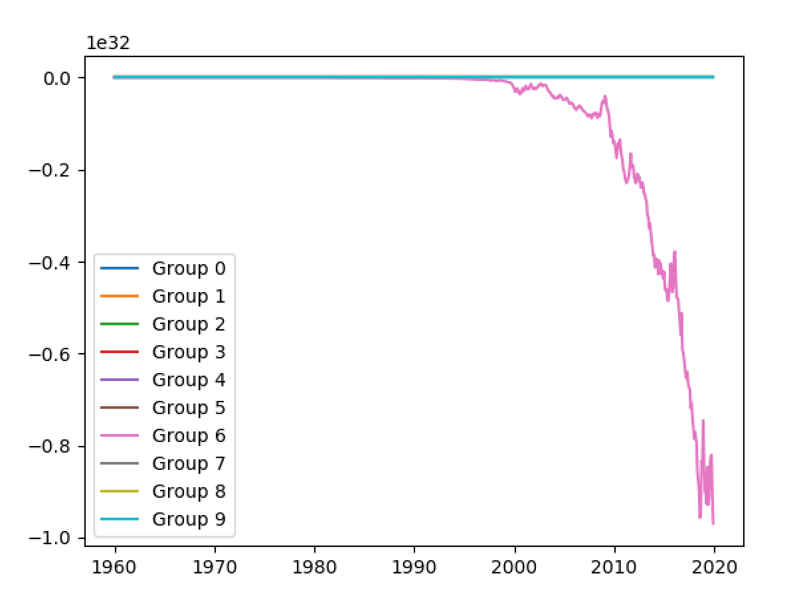
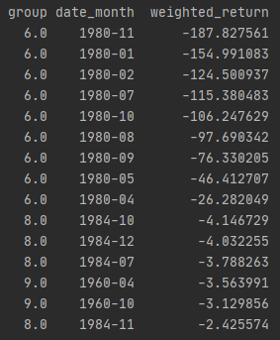
Portfolio Creation

Slide 43
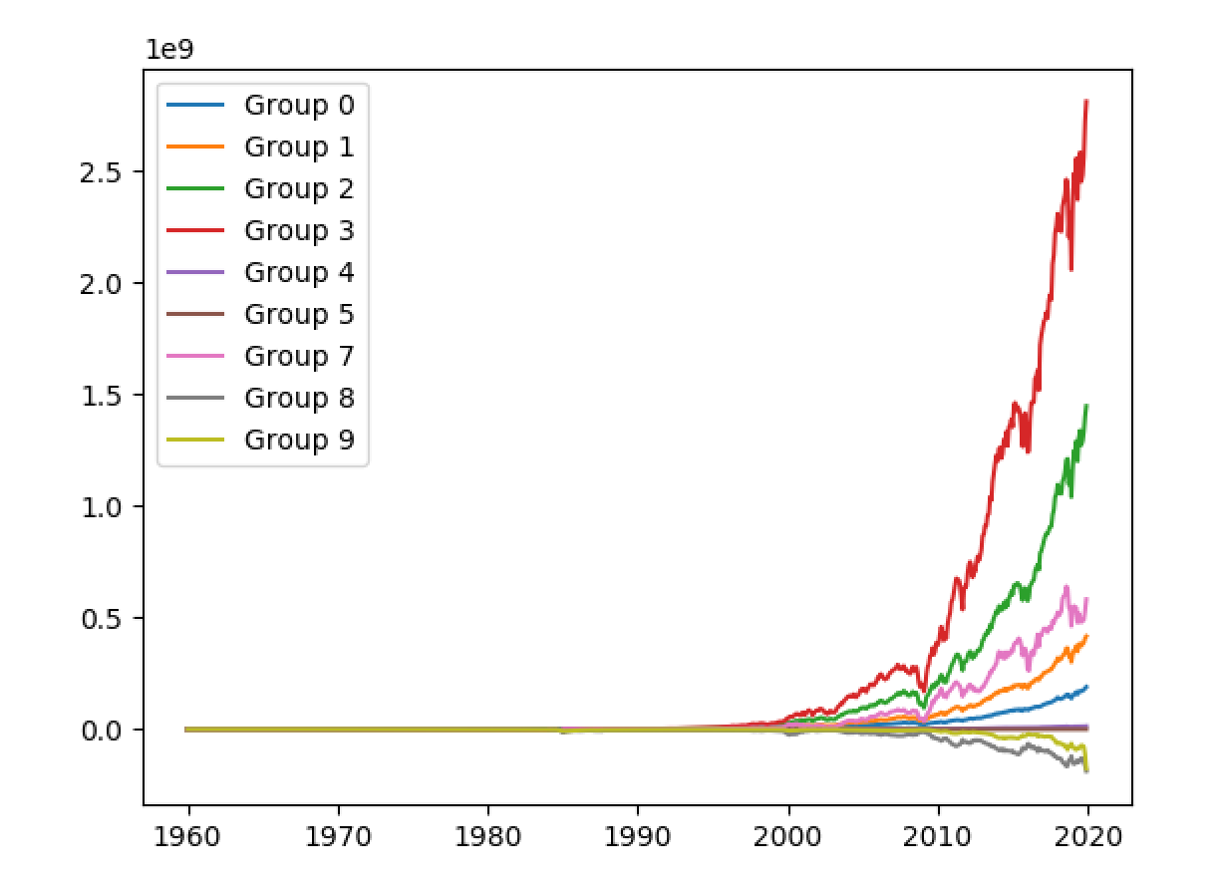
Portfolio Creation Excluding 6

Slide 44
Portfolio Creation Concerns
Clearly, we want to address:
Why is there no change from 1960 to 2000
Why does portfolio 6 in particular blow up well below zero
Does this method of using the entire sample introduce any hindsight concerns?

Slide 45
Future Work
Week 1
Week 2
Week 3
Week 4
Data Collection and Processing
Portfolio Analysis and ML Classification Algorithms
Finalize Data Collection and Begin Model Training (Logit)
Portfolio Analysis and Explore Advance ML Classification Algorithms
Gather Data from all sources necessary, developing comprehensive universe creation rules. Deal with processing data.
Finalize Data Collection Methodology across groups and begin Model Training with Logistic Regression.
Form portfolios based on Logistic Regression Probabilities for Bankruptcies and explore ML Classification Algorithms such as Random Forest, SVG, and Neural Nets.
Finalize ML Classification Algorithms and recalculate portfolios. Compare and analyze results

Slide 46
Questions?
Please ask questions / offer any insights!

